Slide 1

Ethereum wallet using Blockchain Technology
Presented by
Deepika S-210419205009
Sowmika D-210419205047
4 th Year Information Technology
Guided by
Dr. A.R.Kavitha
Associate Professor,
Department of IT
Chennai Institute of Technology
DEPARTMENT OF IT
CHENNAI INSTITUTE OF TECHNOLOGY(An Autonomous Institution)

Slide 2
ABSTRACT
Blockchain technology is an evolving technology which is revolutionizing the IT industry by providing better security and efficiency. This technology can help to solve different kinds of problems in the industrial sphere, such as trust, transparency, security and reliability of data processing.
Many sophisticated problems with smart contracts can be solved with Ethereum and the removal of any third party organization which may interfere in transactions and it is easier to implement compared to other blockchain technologies.
Our aim is to analyze conveniences and difficulties related to the Blockchain integration to a wallet and implement it efficient way.
DEPARTMENT OF IT
CHENNAI INSTITUTE OF TECHNOLOGY(An Autonomous Institution)

Slide 3
OBJECTIVE
Ethereum can be used by anyone to create any secured digital technology.
Ethereum wallets are applications that let you interact with your Ethereum account.
Think of it like an internet banking app – without the bank. Your wallet lets you read your balance, send transactions and connect to applications.
The Ethereum wallet stores the private key (secrets keys with which the user can access the Ether) of the user.
These private keys are only supposed to be known to the wallet’s creator, as anyone who knows them can access their funds.
DEPARTMENT OF IT
CHENNAI INSTITUTE OF TECHNOLOGY(An Autonomous Institution)

Slide 4
PROBLEM DEFINITION
Today, we are seeing many DApps decentralised applications on Ethereum that use token as assets or Cryptocurrency for payments.
However, Ethereum Wallets are insecure when you lose the private key or someone hacks or multiple users are using the same wallet.
For example, you partnered with someone in building a product and raised a funding of USD 1million or some Ether in Initial Coin Offerings (ICO).
The fund could be misused by your partner without your knowledge or there is a risk of losing key or hacker can take all your funds in a single transaction, which is irreversible.
To overcome this issue we cameup with smart contract wallet of Ethereum with multisig.
DEPARTMENT OF IT
CHENNAI INSTITUTE OF TECHNOLOGY(An Autonomous Institution)

Slide 5
LITERATURE REVIEW
Paper Title: Wallet Contracts on Ethereum Monika di Angelo, Gernot Slazer TU Wien, Vienna, Austria {monika.di.angelo,gernot.salzer}@tuwien.ac.at
Atleast 5 slides
Proposed Work: Ethereum is the most prominent platform for both, tokens and smart contracts, and thus also for wallet contracts. We discuss several methods for identifying wallet contracts in a semi-automatic manner by looking at the deployed bytecodes and their interaction patterns. Furthermore, we differentiate characteristics of wallets in use, and group them into six types.
Algorithm: Keccak-256 cryptographic hash function ,Solidity
Summary of Report Findings: This method of computing code skeletons is comparable to the first step for detecting similarities by . Instead of their second step of fuzzy hashing though, they rely on the set of function signatures extracted from the bytecode and manual analysis, as our purpose is to identify wallets reliably.
Issue and Limitations:These wallets use only private key ,once it is lost it cannot be gained access again.
Future Directions: Multig Technology can be added for easier access of data.
DEPARTMENT OF ECE
CHENNAI INSTITUTE OF TECHNOLOGY
DEPARTMENT OF IT
CHENNAI INSTITUTE OF TECHNOLOGY(An Autonomous Institution)

Slide 6
LITERATURE REVIEW
Paper Title: Ethereum Blockchain Wallets Himank Goel1 , Harshit Gupta2 , M.L. Sharma3 , K.C. Tripathi4 1, 2, 3, 4Maharaja Agrasen Institute of Technology, Delhi
Atleast 5 slides
Proposed Work: This paper aims to analyze conveniences and difficulties related to the Blockchain integration to a wallet and implementation in the different fields of modern industry.
Algorithm: Smart Contracts
Summary of Report Findings: With the advantages of the technology, such as the transparency, anonymity, the multiple copying of the transactions and the decentralized digital ledger, the Blockchain technology is reliable and not destructible, and attacks could disrupt the system work, not the technology. There are only a few examples of Blockchain actually getting hacked in practice.
Issue and Limitations:This paper does not explore various applications and technologies in smart contracts.
Future Directions: It is necessary to keep exploring the Blockchain development and application in the different areas for the nearest future, because this new technology can help to solve many difficult problems, which are disturbing and preventing correctly systems work.
DEPARTMENT OF ECE
CHENNAI INSTITUTE OF TECHNOLOGY
DEPARTMENT OF IT
CHENNAI INSTITUTE OF TECHNOLOGY(An Autonomous Institution)

Slide 7
LITERATURE REVIEW
Paper Title: Wallet Contracts on Ethereum Identification, Types, Usage, and Profiles ∗ Monika di Angelo Gernot Salzer TU Wien, Vienna, Austria {monika.di.angelo,gernot.salzer}@tuwien.ac.at April 4, 2021
Atleast 5 slides
Proposed Work: This work aims at a better understanding of wallet contracts on Ethereum, since they are one of the most frequently deployed smart contracts. By analyzing source code, bytecode, and execution traces, we derive usage scenarios and patterns.
Algorithm: Various Wallet Contracts
Summary of Report Findings: They examined smart contracts that provide a wallet functionality on the Ethereum main chain up to block 11 500 000, mined on Dec 22, 2020. For a semi-automatic identification of wallet contracts, they discussed methods based on deployed bytecode and interactions.
Issue and Limitations:This paper does explain it theoretically but there is no proof of concept.
Future Directions: To determine reliably what smart contracts actually implement, it is still indispensable to analyze bytecode. Adequate tool support for a massive automated semantic code analysis would be helpful to obtain a comprehensive picture of the smart contract ecosystem.
DEPARTMENT OF ECE
CHENNAI INSTITUTE OF TECHNOLOGY
DEPARTMENT OF IT
CHENNAI INSTITUTE OF TECHNOLOGY(An Autonomous Institution)

Slide 8
LITERATURE REVIEW
Paper Title: WalliD: Secure your ID in an Ethereum Wallet
Atleast 5 slides
Proposed Work: Wallid is the only protocol dealing with this kind of digitally certified and globally trusted Identities and combines them with the features of decentralization, transparency, immutability and privacy in order to connect the already solved problem of identity trust in the physical world to the online world.
Algorithm: Smart Contract, X. 509 certificate
Summary of Report Findings: This paper presents WalliD, a decentralized approach of a secure protocol to handle customer identification using Blockchain. The paper then shows a proof of concept workflow implementation of this protocol developed using an Ethereum Wallet.
Issue and Limitations:This paper does not explain about various other cons of smart contract except privacy
Future Directions: The legal basis and security requirements of those credentials are regulated in Europe by the standards specified in the eIDAS regulation established by the European Commission. The project's next steps are to comply with these regulations to set the market to cover all European Union and not just the Portuguese market.
DEPARTMENT OF ECE
CHENNAI INSTITUTE OF TECHNOLOGY
DEPARTMENT OF IT
CHENNAI INSTITUTE OF TECHNOLOGY(An Autonomous Institution)

Slide 9
LITERATURE REVIEW
Paper Title: Characteristics of Wallet Contracts on Ethereum Monika di Angelo, Gernot Salzer TU Wien, Vienna, Austria
Atleast 5 slides
Proposed Work: In this work, we investigate smart contracts for wallets with regard to the functionality that makes use of cryptographically secured blockchain technology.
Algorithm: Wallet Contracts
Summary of Report Findings: For a semi-automatic identification of wallet contracts, they discussed methods based on deployed bytecode and interactions. By analyzing source code, bytecode, and execution traces, they derived features and types of wallets in use, and compared their characteristics.
Issue and Limitations:This paper does not explain more about the privacy concerns in contracts
Future Directions: To determine reliably what smart contracts actually implement, it is still indispensable to analyze bytecode. Adequate tool support for a massive automated semantic code analysis would be helpful to obtain a comprehensive picture of the smart contract ecosystem.
DEPARTMENT OF ECE
CHENNAI INSTITUTE OF TECHNOLOGY
DEPARTMENT OF IT
CHENNAI INSTITUTE OF TECHNOLOGY(An Autonomous Institution)

Slide 10
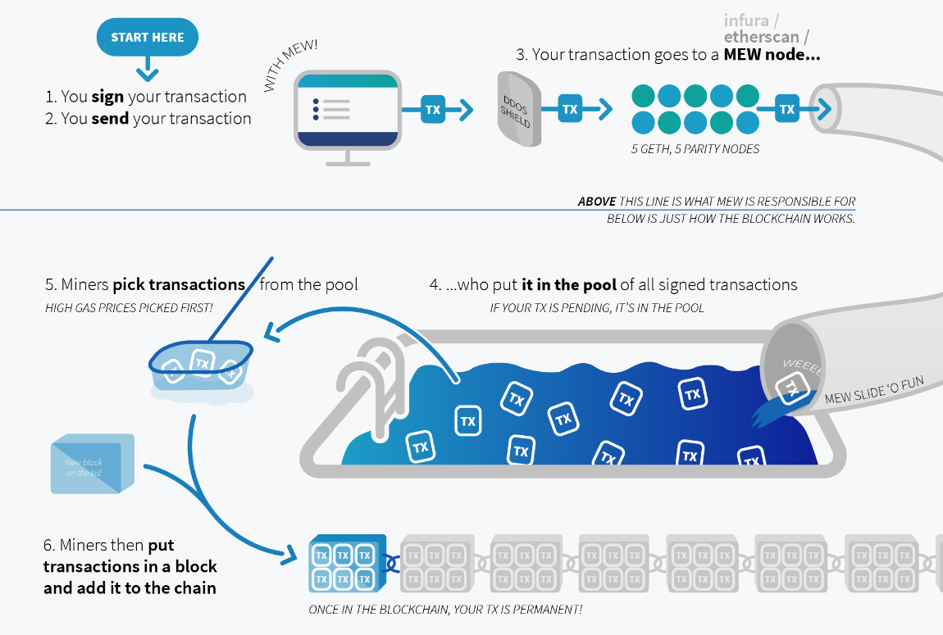
PROPOSED SYSTEM
DEPARTMENT OF ECE
CHENNAI INSTITUTE OF TECHNOLOGY
DEPARTMENT OF IT
CHENNAI INSTITUTE OF TECHNOLOGY(An Autonomous Institution)

Slide 11
REFERENCES
https://www.academia.edu/37658504/Tavares_J_Sawant_M_and_Ban_Olimpia_2018_A_study_of_the_travel_preferences_of_generation_Z_located_in_Belo_Horizonte_Minas_Gerais_Brazil_e_Review_of_Tourism_Research_eRTR_Vol_15_No_2_3_2018_http_ertr_tamu_edu
https://www.researchgate.net/publication/347267055_Characteristics_of_Wallet_Contracts_on_Ethereum
https://scholar.google.com/scholar?as_q=Wallet+Contracts+on+Ethereum&as_occt=title&hl=en&as_sdt=0%2C31
https://ieeexplore.ieee.org/document/9169467/references#references
https://arxiv.org/abs/2001.06909
https://www.researchgate.net/publication/265168254_International_Journal_of_Research_IJR_ISSN_2348-6848
DEPARTMENT OF IT
CHENNAI INSTITUTE OF TECHNOLOGY(An Autonomous Institution)

